Slide 1
Peripheral Security

Slide 2
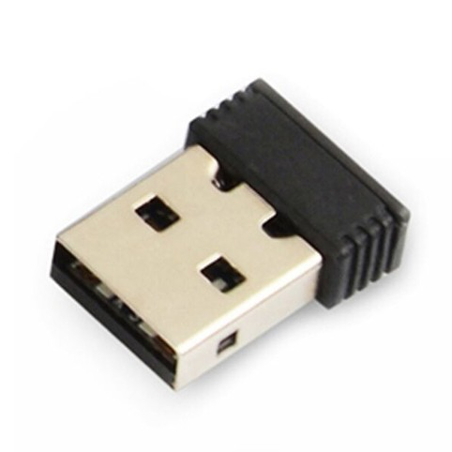
Wireless keyboards and mice
Many wireless keyboards and mice communicate in the clear
Rely on proprietary wireless communication protocols
Usually 2.4GHz frequency
With a receiver, it’s easy to capture keystrokes
Tool called “KeySniffer”
Inject keystrokes and mouse movements wirelessly
Remotely control the computer
Some keyboards support AES
Encryption from the keyboard to the computer

Slide 3
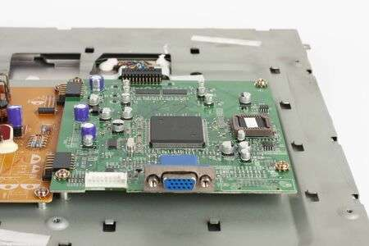
Displays
Electromagnetic radiation
Information on a screen can generate radio signals (called RF)
Internal signals of a laptop or external cable
Eavesdrop through the walls
Firmware hacks
All displays have chips inside to make them operate
Those chips rely on firmware (software for the hardware)
Firmware upgrades usually have no security
Hacked firmware can
Log information on the screen
Ransomware the display (locked until ransom is paid)

Slide 4
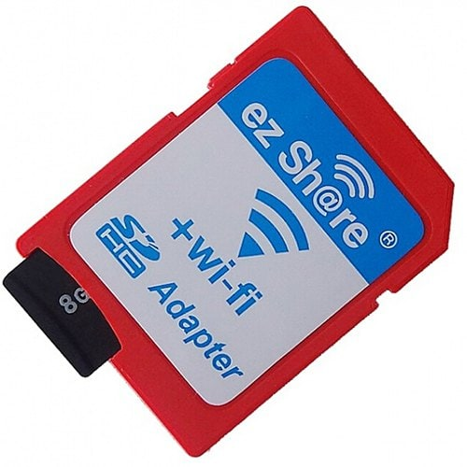
WiFi-enabled SD cards
Combination of SD storage and 802.11 WiFi file transfers
Allows easy transfer of data from a camera to a computer
SD card authentication vulnerabilities
Predictable access, known default passwords
Easy to read files over WiFi
API access to the SD card
Manufacturer must implement strong security (they usually don’t)
API access can result in data leakage or data loss for organization

Slide 5
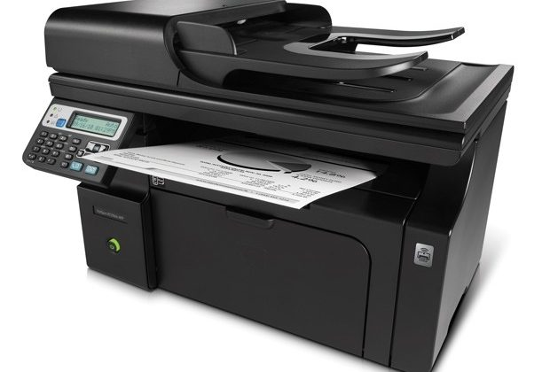
Printers/Multi-function devices
“All-in-one” multi-function devices
Printer, scanner, copier, fax all in one box
Network connectivity
Unauthorized access
Reconnaissance
Log files for all activity
Can be used to glean information
Gather organizational information
Capture spool files
“What’s been printed?”

Slide 6
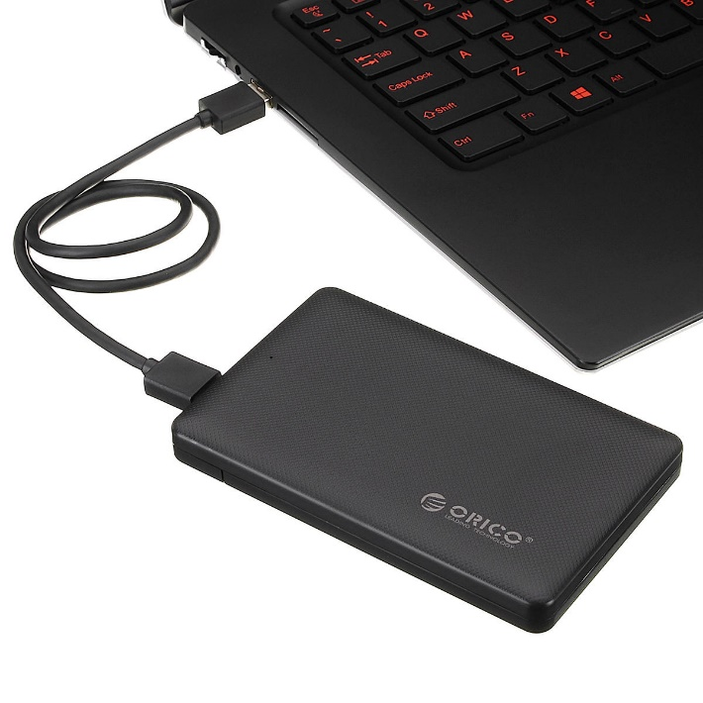
External storage devices
Storage outside the computer, often removable
Extremely portable, easy to move large data
Limited authentication
Anyone can connect and read
Often used for exfiltration of data
Disable USB storage access
No thumb drives allowed
No external storage allowed

Slide 7

Digital cameras
Capture still images and video
Take pictures of sensitive information
Device operates as external storage
Easy to move data around for photographers
Easy to copy data to camera’s storage
Exfiltrate data through the camera
Camera firmware can be compromised
Like most firmware updates, there’s often little security
Security cameras too

